Slide 1


Final Project Proposal
Jennifer Zheng & Lynn Zhou

Slide 2
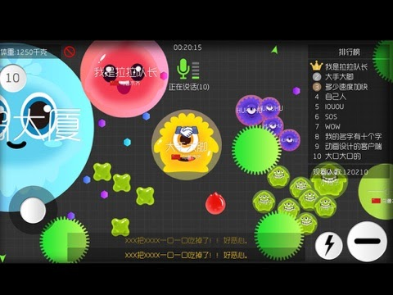
Introduction
We plan to design a game called Survival Under Covid-19. This game is inspired by the Battle of Balls. Different from Battle of Balls, however, our game Survival Under Covid-19 is a human vs computer game which means it only supports one player but not multiple.

Slide 3
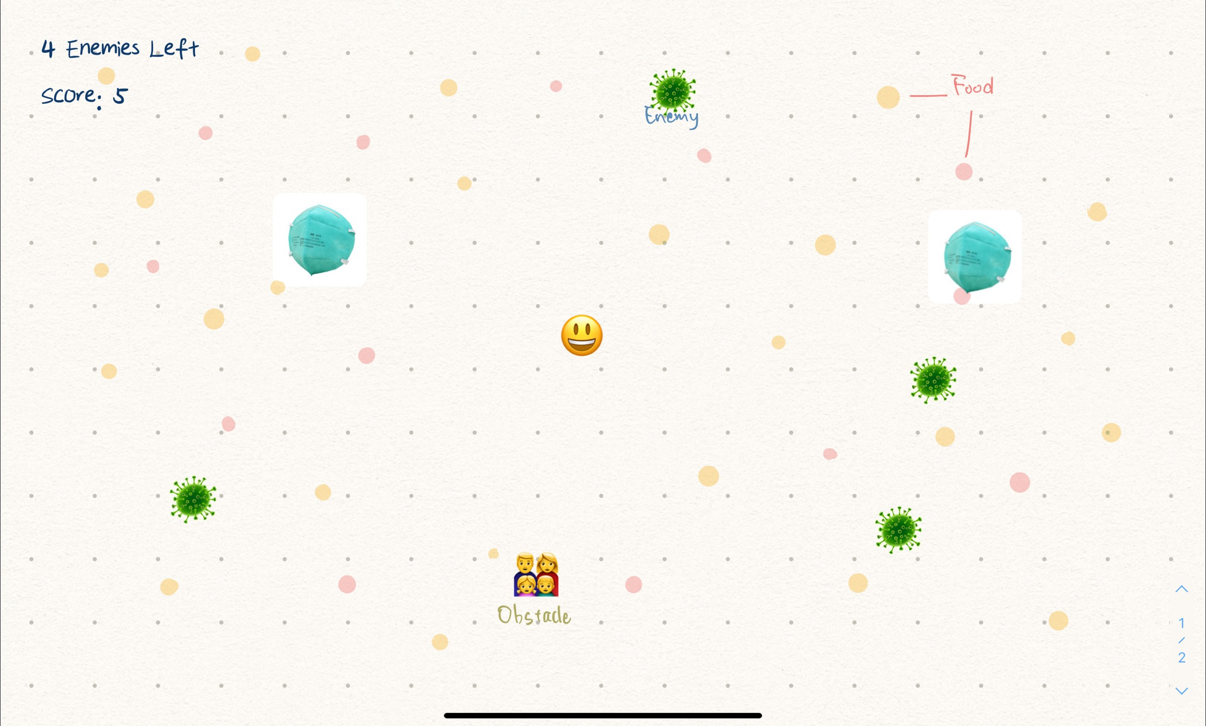
Sample

Slide 4
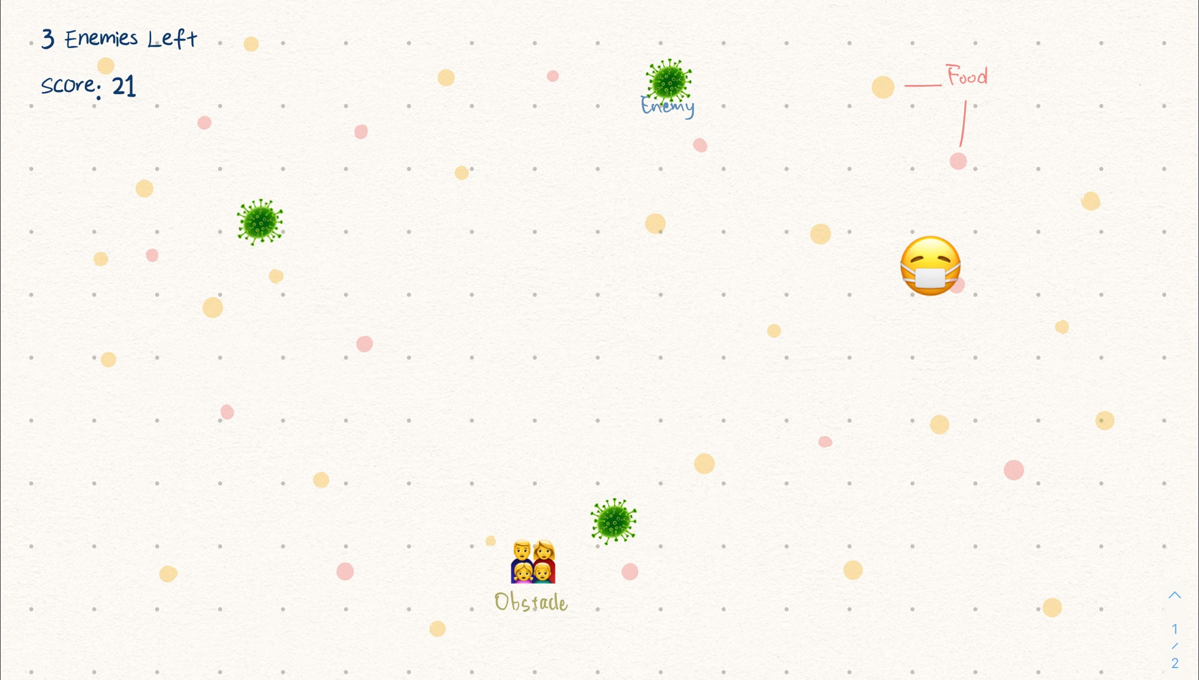
Sample

Slide 5
Features
Map: (Jennifer)
The size of the map will be bigger than the display window. Display should move as the player moves itself out of the current display area.
Food: (Lynn)
Small dots of the same size(diameter of 5 pixels) would randomly generate on the map as food of the player and enemies. As the player and enemies eat the food, they will grow bigger. The dots will disappear after being eaten and then be regenerated on the map after a while.

Slide 6
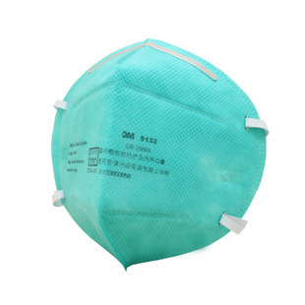
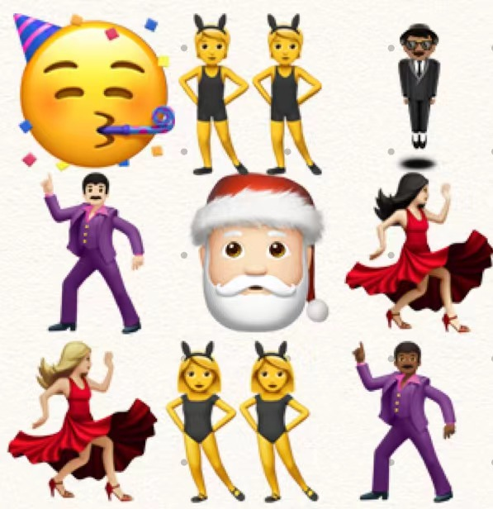
Features
Obstacles: (Lynn)
There are two kinds of obstacles, they both stay at fixed positions.
Obstacle 1:
Image of a mask. The player can eat the mask and gain 10 points. Enemy would eat the mask as well but there will be no score change.
Obstacle 2:
Image of a party. Enemy can eat the party and gain 10 points. Player would die if it touches the party (Game over).

Slide 7
Features
Level of difficulty: (Lynn)
There will be Easy, Medium, and Hard levels. Each level will have a respective amount of enemies and obstacles.
Score: (Jennifer)
Each small ball represents 1 point, each enemy at start of the game represents 5 points. Each time a player eats one small ball, the player gains 1 point. Each time the enemy eats one small ball, the points of the enemy increases by 1. When the player eats an enemy, the player gains points that the enemy represents.

Slide 8


Player Features
Player will be displayed by the image of the human figure with a diameter of 10 pixels in the middle of the map.
Player starts with 5 points.
Movement of the player consists of left,right,up,down keys.
Each time the player gains one point, the diameter of the player ball increases by 5 pixels.
If the player bumps into an enemy that is larger, the player would be eaten by the enemy (Game over)
If a player bumps into a party, the player would die and game over.
If a player bumps into a mask, he puts it on and gains 10 points.
For the player to win, he needs to clear all enemies from the map.

Slide 9

Enemy Features
Generates randomly on the map beginning with circles of a diameter of 10 pixels.
Each enemies start with 5 points. The points of each enemy will be printed in the middle of the image.
Each time an enemy gains one point, the diameter of the enemy ball increases by 5 pixels.
Enemy moves randomly.
If an enemy runs into a party, enemy eats the party and gains 10 points.
If an enemy runs into a player(larger or equal), the enemy gets eaten by the player.
Countdown for the number of enemies left will be displayed.

Slide 10
Difficulties
Regenerate dots(food) after it’s being eaten
Make sure the enemy is randomly distributed on the map but not crowded at one certain area
the map will move as the player moves itself out of current displayed area
Make sure the computer-generated enemy knows to move to area with food

